Slide 1
Data Link Layer

Slide 2
Functions of the Data Link Layer
The goal of the data link layer is to provide reliable, efficient communication between adjacent machines connected by a single communication channel.
Specifically:
Framing
Error Control -Error Correction & Detection
Flow control
Provide service to the network layer.
- The network layer wants to be able to send packets to its neighbors without worrying about the details of getting it there in one piece.

Slide 3
Framing
Fixed-Size Framing : In fixed-size framing, there is no need
for defining the boundaries of the frames; the size itself can be
used as a delimiter. Example ATM
Variable-Size Framing : In variable-size framing, we need a
way to define the end of the frame and the beginning of the
next.
Types :
1. Bit Stuffing: Use reserved bit patterns to indicate the start and end of a frame. For instance, use the 4-bit sequence of 0111 to delimit consecutive frames. A frame consists of everything between two delimiters
2. Character stuffing: Same idea as bit-stuffing, but operates on bytes instead of bits. Use reserved characters to indicate the start and end of a frame.

Slide 4
Error Control
Acknowledgements
Timers
Sequence Numbers

Slide 5
Error Detection and Correction
In data communication, line noise is a fact of life (e.g., signal attenuation, natural phenomenon such as lightning, and the telephone repairman).
Moreover, noise usually occurs as bursts rather than independent, single bit errors. For example, a burst of lightning will affect a set of bits for a short time after the lightning strike.
Detecting and correcting errors requires redundancy -- sending additional information along with the data.
There are two types of attacks against errors:
Error Detecting Codes:
Include enough redundancy bits to detect errors and use ACKs and retransmissions to recover from the errors.
Error Correcting Codes:
Include enough redundancy to detect and correct errors.

Slide 6
Flow Control
Flow control deals with throttling the speed of the sender to match that of the receiver. Usually, this is a dynamic process, as the receiving speed depends on such changing factors as the load, and availability of buffer space.

Slide 7
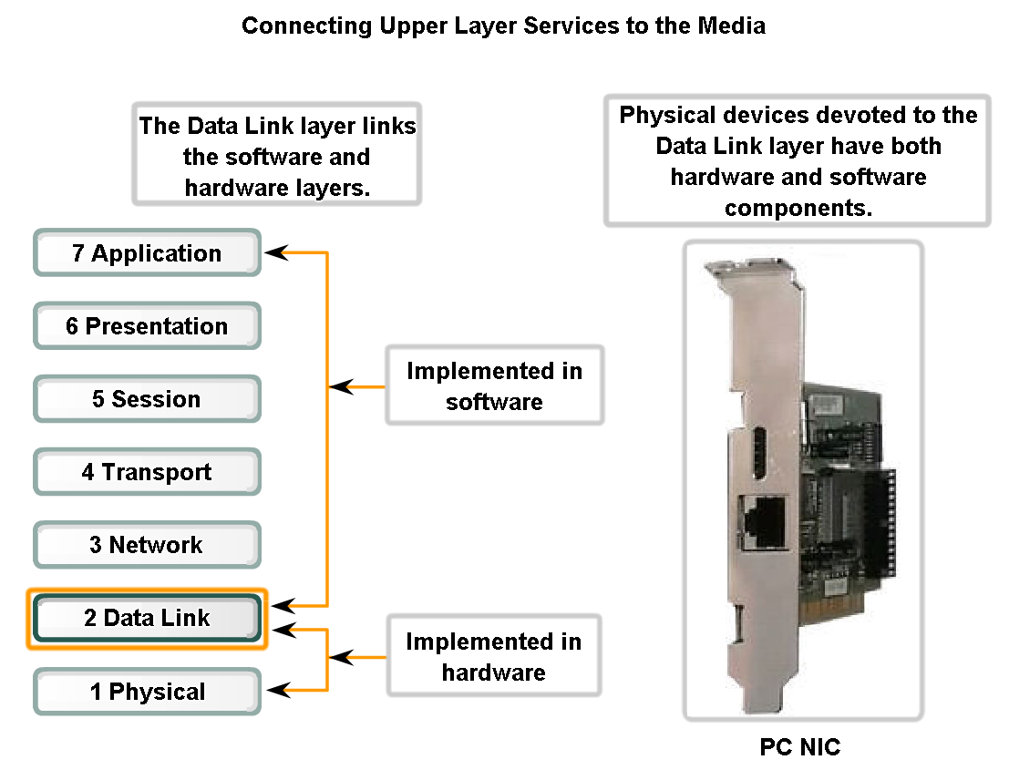
Data Link Layer – Accessing the Media
Logical Link Control : The LLC sublayer is primarily concerned with:
Multiplexing protocols transmitted over the MAC layer (when transmitting) and decoding them (when receiving).
Providing node-to-node flow and error control
Media Access Control: MAC determines who is allowed to access the media at any one time (usually CSMA/CD).

Slide 8
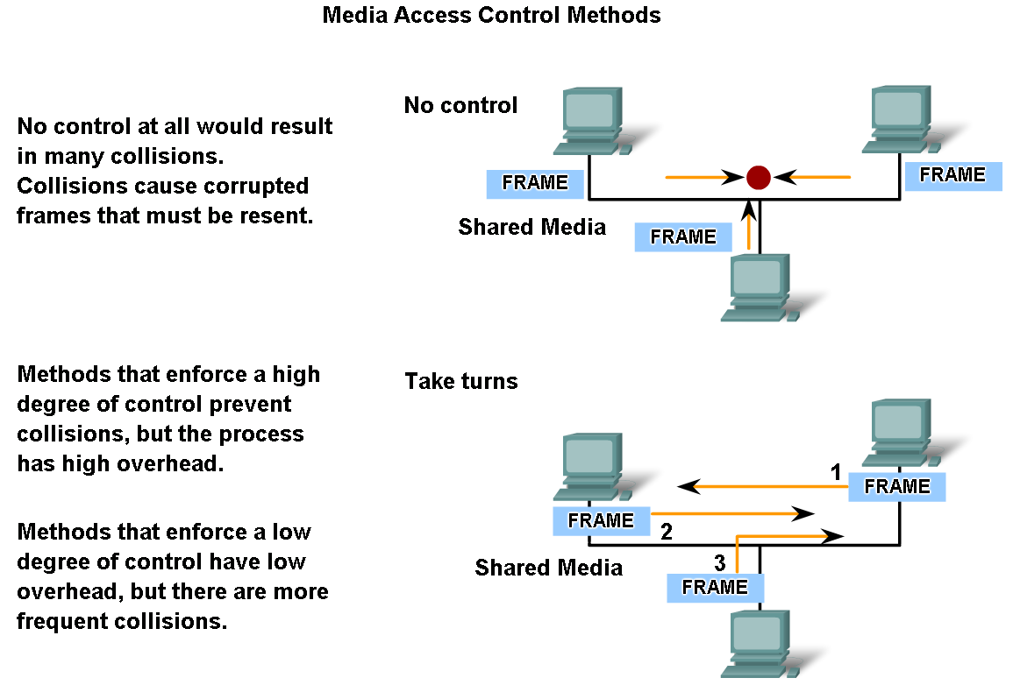
Media Access Control Techniques

Slide 9
Media Access Control Techniques
There are two basic media access control methods for shared media:
Controlled - Each node has its own time to use the medium
Contention-based - All nodes compete for the use of the medium

Slide 10
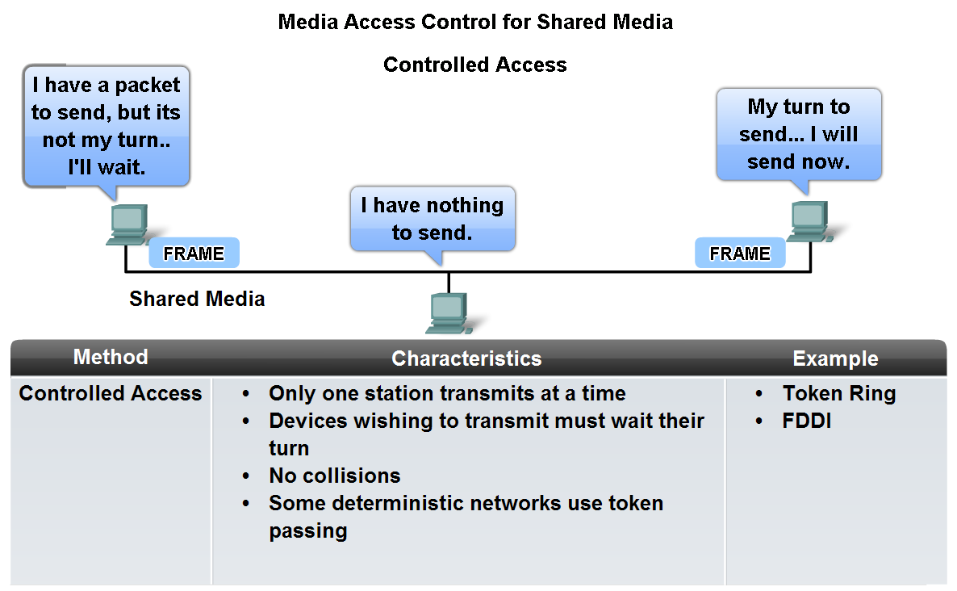
Controlled Access

Slide 11
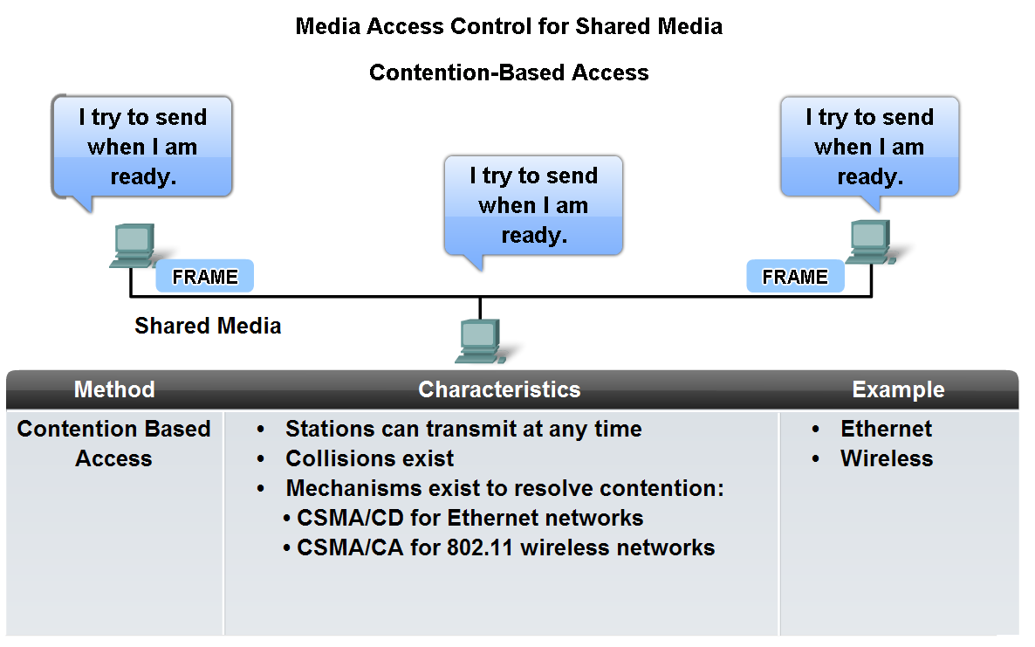
Contention Based Access

Slide 12
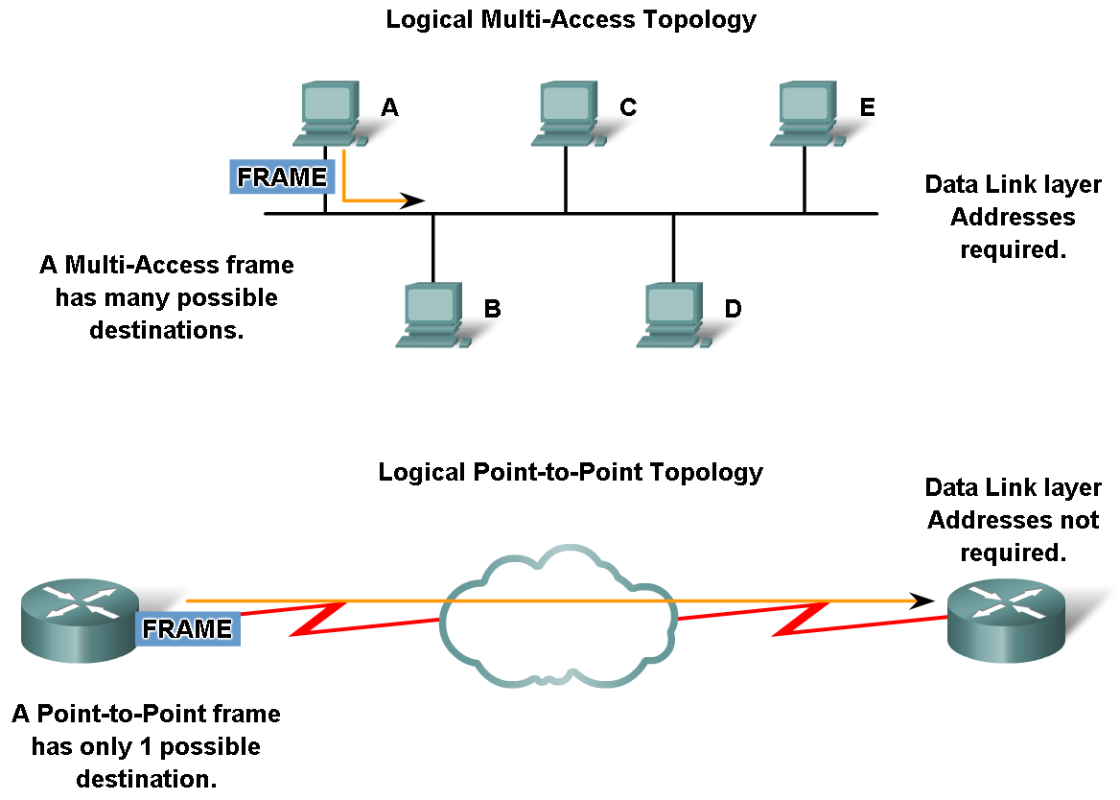
Media access control addressing and framing data
Role of addressing in the Data Link layer and identify cases where addresses are needed and cases where addresses are not needed

